Slide 1
Higher Biology
Gene Expression
Mr G R Davidson

Slide 2
Protein Structure
The genetic makeup of an organism, i.e. the genotype, is determined by the base sequence of DNA.
When these genes are expressed, certain proteins are made and this determines the organism’s phenotype.
All proteins contain the elements carbon, hydrogen, oxygen and nitrogen. (CHON)

Slide 3
Protein Structure
Some proteins contain sulphur(S) and phosphorous(P).
These elements are built up into amino acids which are the sub-units of all proteins.
Protein molecules vary in length from just a few amino acids to many thousands of amino acids.

Slide 4
Protein Structure
The amino acids form chains and are joined together by peptide bonds.
These chains are then called polypeptides.
The polypeptides become folded or coiled when they are forming, and they are held together by hydrogen bonds.
Depending on how the amino acids interact with each other, depends on the final shape of the protein.

Slide 5
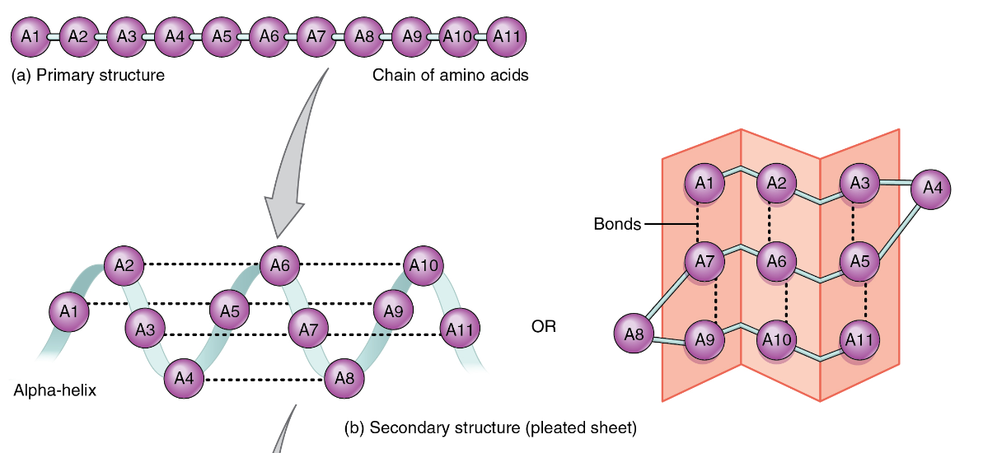
Protein Structure
Peptide bond
Hydrogen bond
Hydrogen

Slide 6
Protein Structure
Some proteins form in long parallel strands and these are called fibrous proteins.
Other proteins are roughly ball-shaped and these are called globular proteins.
There exists a huge range of shapes and structures of proteins and these have a huge range of functions.

Slide 7
Functions of Proteins
Structural proteins are found in every cell in the structure of the plasma membrane.
Antibodies are Y-shaped proteins and they defend the body against antigens.

Slide 8
Functions of Proteins
Enzymes are proteins which are folded in a certain way to create an ‘active site’ which is specific to a certain substrate.
Hormones are proteins which act as chemical messengers designed to have an effect on a ‘target organ’.
There are some proteins which combine with non-protein molecules such as carbohydrates, and we call these glycoproteins, e.g. mucus.

Slide 9
Protein Synthesis
A protein’s exact structure is determined by the base sequence of DNA.
Proteins are constructed in the ribosomes and therefore the code for the protein has to be taken from the DNA in the nucleus to the ribosome.
This is done using a nucleic acid called ribonucleic acid (RNA).

Slide 10
Protein Synthesis
RNA is constructed in a similar way to DNA in that it is made of nucleotides.
However, the nucleotides of RNA are made of ribose sugar, phosphate and a base.
P
ribose sugar
Base

Slide 11
Protein Synthesis
The bases are the same as DNA except that uracil (U) replaces thymine (T).
RNA is also only a single strand unlike DNA which is a double strand.

Slide 12
Protein Synthesis
The sequence of bases along a strand of DNA is anything but random.
The order of bases is called the genetic code.
The code is actually a ‘recipe’ for protein production.

Slide 13
Protein Synthesis
Proteins are chains of amino acids of which there are twenty in nature , so it follows that the DNA code should be able to specify at least 20 different items.
To do this, the bases of DNA are grouped in threes, these are called triplets of bases, each containing a triplet code for a specific amino acid.

Slide 14
Protein Synthesis
DNA occurs in the nucleus of a cell, and protein synthesis on the ribosomes in the cytoplasm, therefore something must happen which transfers information from one place to another.
Protein synthesis occurs in two stages:
Transcription
Translation

Slide 15
Transcription
The information contained in the DNA code has to be collected and taken out of the nucleus and this is done by another nucleic acid called Ribonucleic Acid (RNA).
There are two types of RNA
1. messenger RNA (mRNA)
2. transfer RNA (tRNA)

Slide 16
Transcription
During protein synthesis, the appropriate region of DNA temporarily opens up to expose the bases to produce a strand of mRNA which then leaves the nucleus through the pores.
RNA polymerase is the enzyme in charge of transcription and nucleotides are added from the 3’ end.
Transcription starts at the ‘promoter region’ of the DNA and ends at the DNA terminator sequence.

Slide 17
Transcription
The mRNA template is made of triplet bases called codons and is called the primary transcript.
The original DNA template is made up of coding and non-coding sections.
The coding sections are called exons and the non-coding sections are called introns.
This means the primary transcript is made up of exons and introns.
exon
exon
intron
exon
intron
exon
intron
exon
intron

Slide 18
Transcription
The introns have a number of functions:
Transcribed to form RNA but they are not translated in to proteins.
Some are mistakes.
Regulation of transcription, e.g. switching off neighbouring genes.
Once the primary transcript is made, the introns need to be cut out and the exons are then spliced together to form the complete mRNA molecule.

Slide 19
Transcription
exon
exon
intron
exon
intron
exon
intron
exon
intron
Primary transcript is chopped up to release the introns.
exon
intron
exon
intron
exon
intron
exon
intron
The exons are now spliced together
to produce the mRNA strand.
The introns are discarded.
exon
exon
exon
exon
intron
intron
intron
mRNA now used in
translation at the ribosome.
intron

Slide 20
Translation
Once the mRNA leaves the nucleus, it becomes attached to a ribosome.
In the cytoplasm, there is another nucleic acid called transfer RNA (or tRNA).
These molecules contain only 3 bases called an anticodon, which corresponds to a specific codon on the mRNA.

Slide 21
Translation
There are many different types of tRNA in a cell and they are each responsible for carrying an amino acid specific to that code.
Translation begins using the start codon of AUG.
tRNA molecules then transport their specific amino acids to the ribosome.

Slide 22
Translation
The codon and anticodon pair up.
The next tRNA molecule then delivers its amino acid to the ribosome and when they are next to each other a peptide bond forms between the two amino acids.

Slide 23
Translation
This process continues until a stop codon is reached (UAA or UAG or UGA)
Once the mRNA has passed through the ribosome, a complete polypeptide chain will have been constructed.
It will then pass through another ribosome and produce another of the same polypeptide.
If the mRNA passes through a number of ribosomes at the same time, we call them polyribosomes.

Slide 24
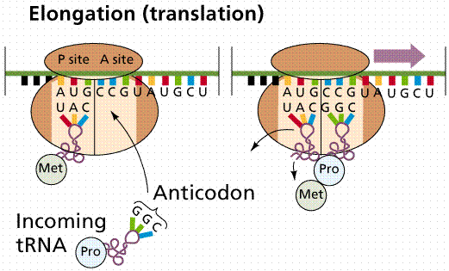
Translation

Slide 25
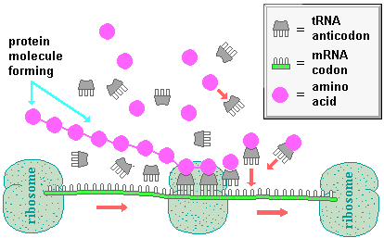
Protein Synthesis

Slide 26
One Gene, Many Proteins
One gene is capable of coding for more than one protein.
Whereas in the code for one protein there are the exons and introns, the same mRNA molecule may also use the exons as introns for another proteins and vice versa for the introns.

Slide 27
One Gene, Many Proteins
e.g. an original mRNA transcript might look like this:
Protein A
Protein B
exon
intron
exon
intron
exon
intron
exon
intron
intron
exon
exon
intron
intron
exon
intron
exon
intron
intron
intron
intron
intron
intron
intron
intron
exon
exon
exon
exon
exon
exon
exon
exon
exon
exon
exon
exon
exon
exon
exon
exon
Protein A
Protein B

Slide 28
One Gene, Many Proteins
After translation there may be further modifications made to the protein in order for it to carry out its particular function.
Amino acids may be cut out of a polypeptide chain by enzymes in a process called cleavage.
Two polypeptide chains may be joined together, e.g. insulin.
A carbohydrate may be added to the polypeptide chain to produce glycoproteins
A phosphate group may be added to the polypeptide chain to produce regulatory proteins.

